Slide 1
Electric Field and
Electric Field due to Dipole

Slide 2
GROUP MEMEBERS
Abrar Hossain Zahin
2022-2-60-040
Arman Hossain
2022-2-60-043
Fariha Khandaker Moon
2022-2-60-047
Sadia Afrin
2022-2-60-037

Slide 3
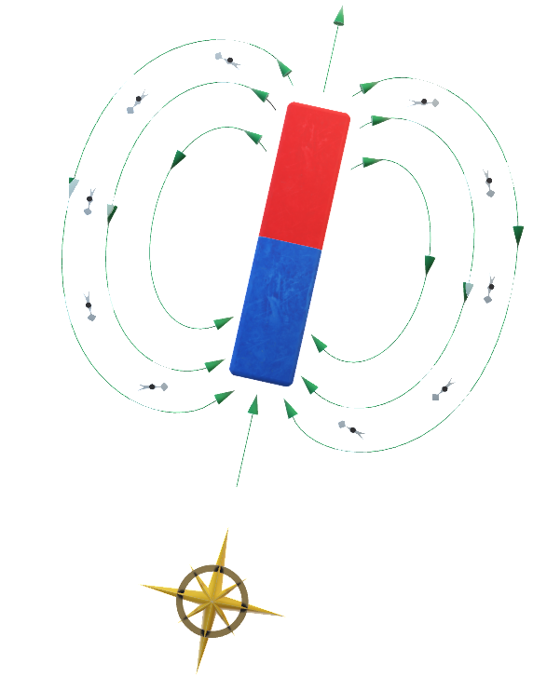



Electric Field
Electric force between a charge and unit positive charge
Is called electric field
The S.I unit of electric field is N/C
Electric field is vector quantity
It is also called Force per unit Charge
Electric field intensity,
E$=\frac{F}{q}$
So the Coulomb force between two charges
is given by,
F$=K∗\frac{|q|∗|q∘|}{r^{2}}$
E$=\frac{1}{4πε}∗\frac{|q|}{r^{2}}$

Slide 4
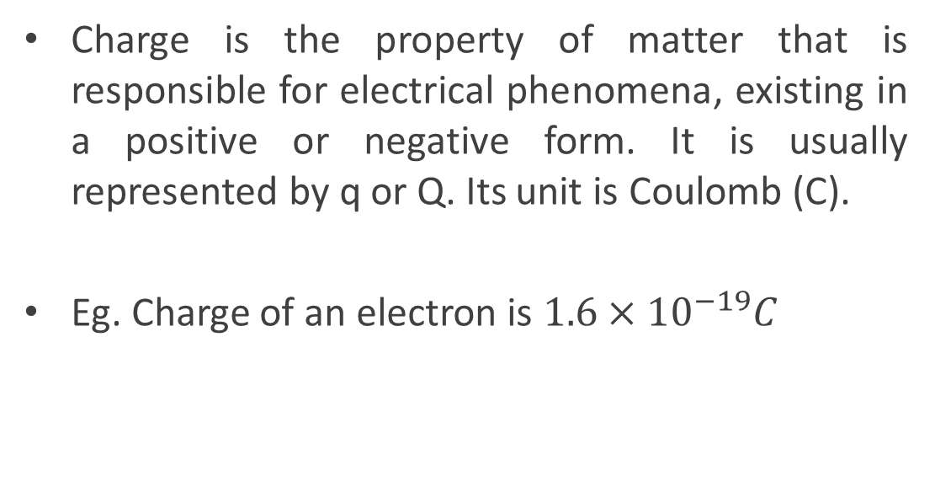
What is Charge
Charge is the property of matter that is responsible for electrical phenomena, existing in a positive or negative form. It is usually represented by q or Q. Its unit is Coulomb (C).
Eg. Charge of an electron is $1.6×{10}^{−19}C$

Slide 5
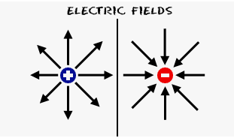
Direction of Electric Field
If the charge is positive then direction of electric field is radially outward
If the charge is negative then the direction of electric field is radially inward

Slide 6
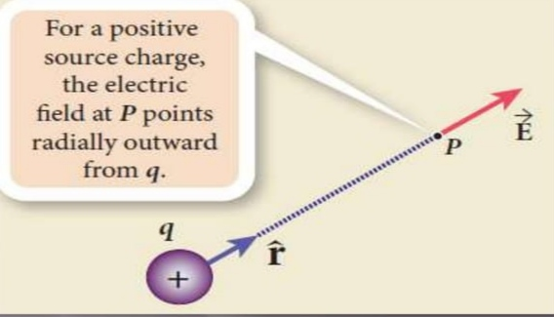
Electric field of positive charges

Slide 7
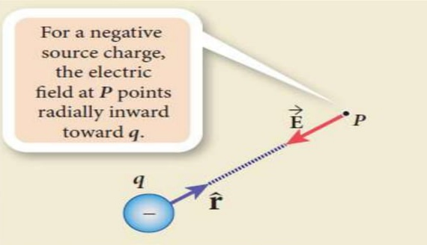
Electric field of Negative charges

Slide 8
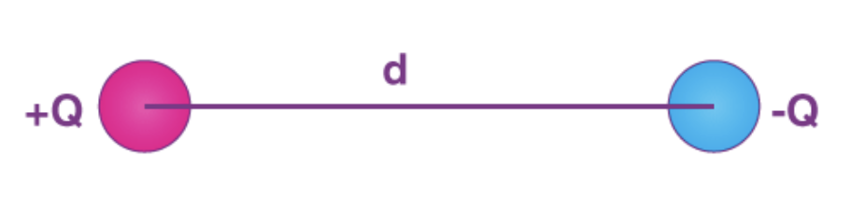

What is Electric Dipole ?
Electric dipole moment is defined as the product of magnitude of
either charges and the distance between the positive and negative
charge of the electric dipole.
Dipole moment,
P$=Q∗d$

Slide 9
How to electric field works due to dipole
Two equal and opposite charges separated by some distance constitute a dipole. The electric field strength due to a dipole, far away, is always proportional to the dipole moment and inversely proportional to the cube of the distance. Dipole moment is the product of the charge and distance between the two charges

Slide 10
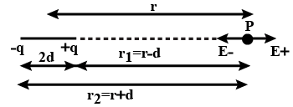
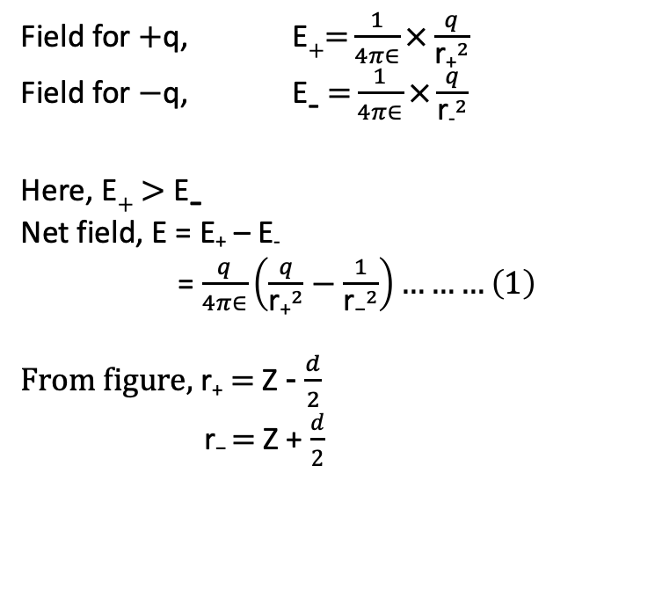
Electric Field due to dipole
Field for $+$q, E$+=$ $\frac{1}{4π∈}×\frac{q}{{\text{r}\text{+}}^{2}}$
Field for $−$q, E₋$=$ $\frac{1}{4π∈}×\frac{q}{{\text{r}\text{−}}^{2}}$
Here, E$+$ $>$ E₋
Net field, E = E₊ – E₋
= $\frac{q}{4π∈}\left(\frac{q}{{\text{r}\text{+}}^{2}}−\frac{1}{{\text{r}\text{−}}^{2}}\right)………\left(1\right)$
From figure, $\text{r}\text{+}$ = Z - $\frac{d}{2}$
$\text{r}\text{−}$= Z + $\frac{d}{2}$
d
d/2
d/2

Slide 11
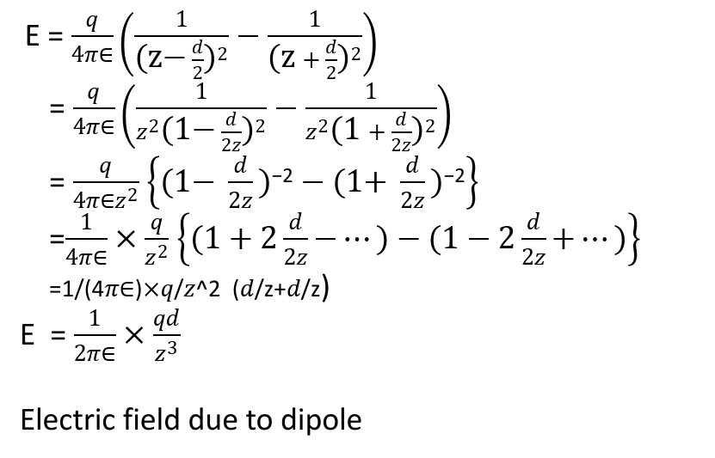

From eq (1)$→$
E = $\frac{q}{4π∈}\left(\frac{1}{{\text{(}\text{z}\text{−} \frac{d}{2}\text{)}}^{2}}−\frac{1}{{\text{(}\text{z} + \frac{d}{2}\text{)}}^{2}}\right)$
= $\frac{q}{4π∈}\left(\frac{1}{{z^{2}\text{(1}\text{−} \frac{d}{2z}\text{)}}^{2}}−\frac{1}{z^{2}{\text{(}\text{1} + \frac{d}{2z}\text{)}}^{2}}\right)$
= $\frac{q}{4π∈z^{2}}$ $\left\{\text{(1}\text{−} \frac{d}{2z}\text{)}\text{−2}−\text{(1+} \frac{d}{2z}\text{)}\text{−2}\right\}$
=$\frac{1}{4π∈}×\frac{q}{z^{2}}$ $\left\{\text{(1}+2\frac{d}{2z}\text{−}…\text{)}−\text{(1}−2\frac{d}{2z}\text{+}…\text{)}\right\}$
=1/(4𝜋∈)×𝑞/𝑧^2 (𝑑/z+𝑑/z)
E = $\frac{1}{2π∈}×\frac{qd}{z^{3}}$
Electric field due to dipole

Slide 12
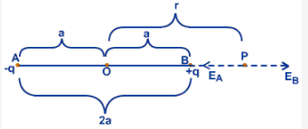
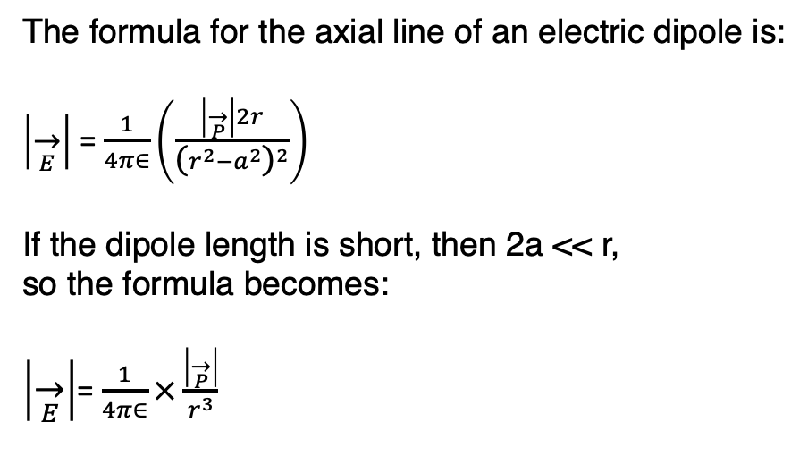
On axial line of dipole
The formula for the axial line of an electric dipole is:
$\left|\overset{→}{E}\right|$ = $\frac{1}{4π∈}\left(\frac{\left|\overset{→}{P}\right|2r}{{\text{(}r^{2}−a^{2}\text{)}}^{2}}\right)$
If the dipole length is short, then 2a << r,
so the formula becomes:
$\left|\overset{→}{E}\right|$= $\frac{1}{4π∈}×\frac{\left|\overset{→}{P}\right|}{r^{3}}$

Slide 13
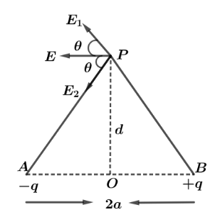
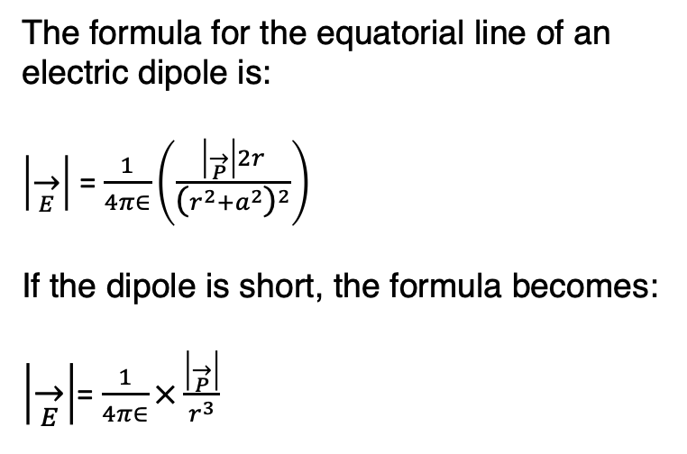
On Equatorial line of dipole
The formula for the equatorial line of an electric dipole is:
$\left|\overset{→}{E}\right|$ = $\frac{1}{4π∈}\left(\frac{\left|\overset{→}{P}\right|2r}{{\text{(}r^{2}{+a}^{2}\text{)}}^{2}}\right)$
If the dipole is short, the formula becomes:
$\left|\overset{→}{E}\right|$= $\frac{1}{4π∈}×\frac{\left|\overset{→}{P}\right|}{r^{3}}$

Slide 14
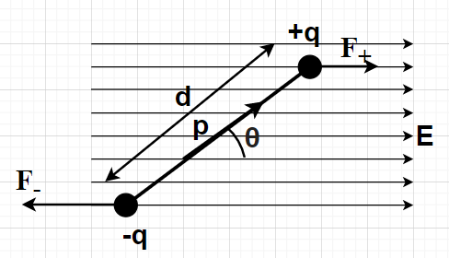
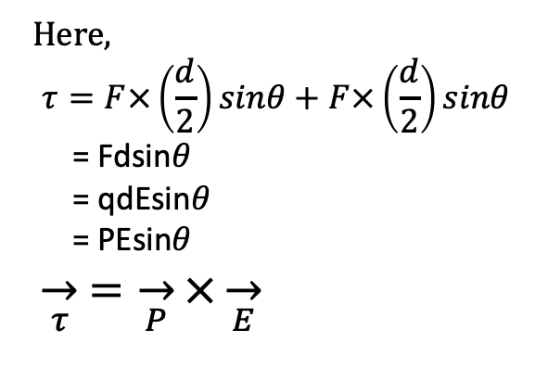
Dipole in Electeic Field
Here,
$$τ=F×\left(\frac{d}{2}\right)sinθ+F×\left(\frac{d}{2}\right)sinθ$$
= Fdsin$θ$
= qdEsin$θ$
= PEsin$θ$
$\overset{→}{τ}$ $=\overset{→}{P}×\overset{→}{E}$
The electric field generated by the dipole is proportional to the
dipole moment.

Slide 15
Examples of Electric Field due to Dipole
Water Molcules.
Electrostatic Induction.
Electrostatic Generator.
Polarized capacitors.
Polarized molecules in electric field.

Slide 16
THANK YOU SO MUCH
FOR
BEING WITH US !!!!

